Slide 1
Chapter 19

Slide 2
Objectives

Slide 3
Objectives (cont.)

Slide 4
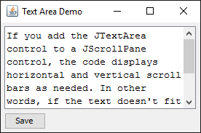
A frame with a text area that has a scroll bar

Slide 5
The JTextArea class

Slide 6
Code that declares a text area

Slide 7
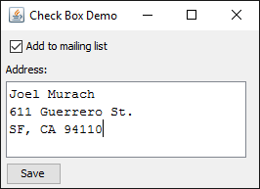
A frame with a check box

Slide 8
The JCheckBox class

Slide 9
Code that declares a check box

Slide 10

A frame with three radio buttons

Slide 11
The JRadioButton class

Slide 12
Code that declares three radio buttons

Slide 13
Code that determines which radio button is selected

Slide 14
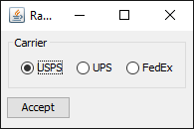
Radio buttons in a panel with a title and a border

Slide 15
Static methods of the BorderFactory class

Slide 16
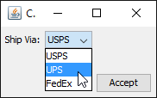
A frame with a combo box

Slide 17
The JComboBox class

Slide 18
Code that declares a combo box

Slide 19
Another way to create a combo box and fill it with items

Slide 20
A frame that includes a list

Slide 21
The JList class

Slide 22
Code that declares a list

Slide 23
A list that allows its elements to be modified

Slide 24
The DefaultListModel class

Slide 25
Code that declares a list and its model

Slide 26
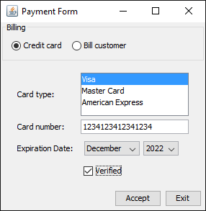
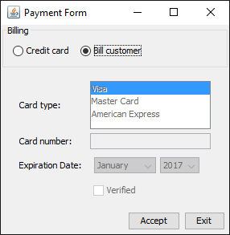
The user interface for the Payment application

Slide 27
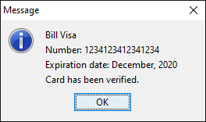
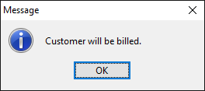
Typical dialog boxes displayed by the application

Slide 28
The code for the Payment application

Slide 29
The code for the Payment application (cont.)

Slide 30
The code for the Payment application (cont.)

Slide 31
The code for the Payment application (cont.)

Slide 32
The code for the Payment application (cont.)

Slide 33
The code for the Payment application (cont.)

Slide 34
The code for the Payment application (cont.)

Slide 35
The code for the Payment application (cont.)

Slide 36
The code for the Payment application (cont.)

Slide 37
The code for the Payment application (cont.)

Slide 38
The code for the Payment application (cont.)

Slide 39
The code for the Payment application (cont.)

